Slide 1
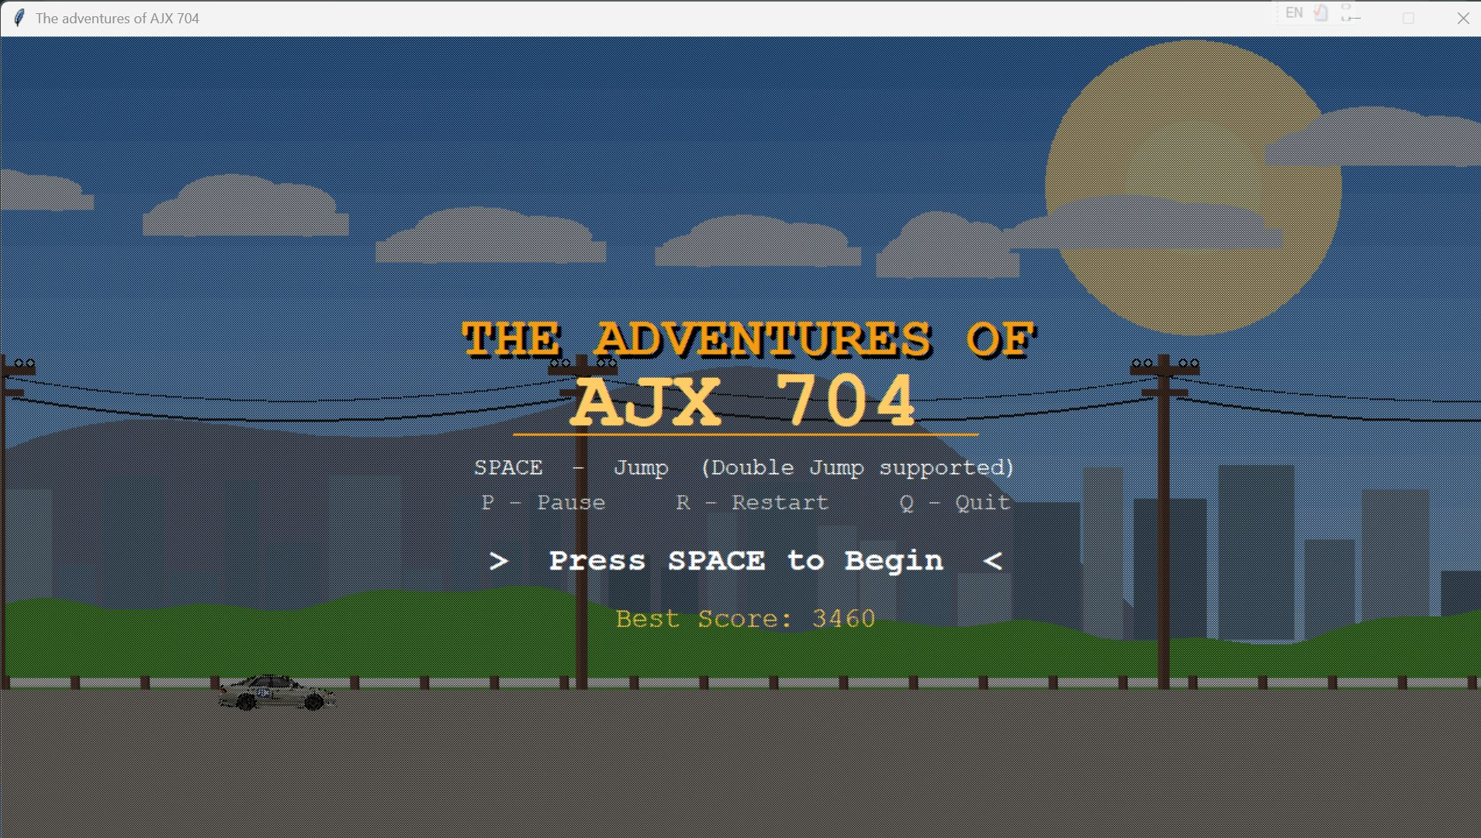
ICT PROJECT · COMSATS UNIVERSITY
THE ADVENTURES OF
AJX 704
BROKEN HIGHWAY
A Real-Time Arcade Game built with Pure Python + Tkinter
No game engine · No external libraries · 60 FPS
Abdul Salam
Muhammad Fazal E Rabbi
SP26-BSE-004
SP26-BSE-044
Python · Tkinter · OOP · Physics Engine · Game Loop · FSM · 2026

Slide 2
PROJECT INTRODUCTION
01
WHAT IS IT?
WHY WE BUILT IT?
Broken Highway is an arcade game where you drive the legendary AJX-704 (X90 Toyota Mark II) on a crumbling suspended highway bridge.
Press SPACE to jump over gaps — supports Double Jump. Fall through a gap and it's Game Over.
Built using Python's standard library only — no Unity, no Pygame, no external dependencies.
01
Modern engines (Unity, Godot) hide the fundamental CS concepts — we wanted raw control over every pixel.
02
Implementing real gravity, AABB collision, and a 60 FPS render loop without any library is a genuine engineering challenge.
03
A game format makes CS101 concepts — Variables, Loops, Conditionals, OOP — visual, tangible, and satisfying.
04
Tribute to a real drift car (the AJX-704) beloved by our group — meaningful and personal.

Slide 3
KEY FEATURES
02
01
Double Jump
02
7-Layer Parallax
03
AABB Collision
Press SPACE mid-air for a 2nd burst. Physics-accurate vertical kinematics — configurable gravity & jump velocity.
Sky gradient, sun/moon, mountains, skyscrapers, wires — all rendering at different scroll speeds for depth.
Axis-Aligned Bounding Box detects car–gap intersections every frame at 60 FPS. One miss = Game Over.
04
Dynamic Scoring
05
Juice Engine
06
Day → Night Cycle
Score = distance × 0.5 + gaps × 100. Speed spikes at milestones. Best score persisted to highscore.txt.
Hard landings fire screen-shake + directional spark particles proportional to fall height. Combo floaters: GREAT!, AJX!
Palette shifts as score rises. Rain, lightning, and headlight cones activate automatically at night.

Slide 4
PROJECT FLOW
03
STARTUP
60 FPS GAME LOOP
OUTCOME
Program Start
Apply Gravity
Draw Scene (7 Layers)
Pick Resolution
Move Car (vy)
⬦ Collision?
Create Window
⬦ On Ground?
STATE = DYING
⬦ SPACE Press?
Check Gap Collision
Car Falls Off Screen
3 → 2 → 1 → GO!
Move Gaps Left
GAME OVER
STATE = PLAYING
Update Score + Speed
R = Restart · Q = Quit
↩ R key loops back to countdown

Slide 5
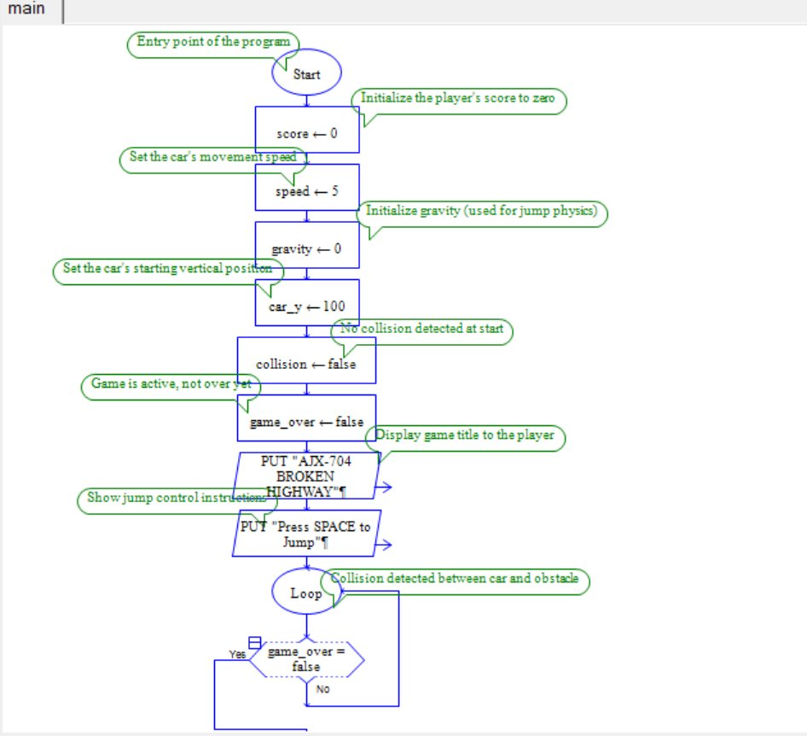
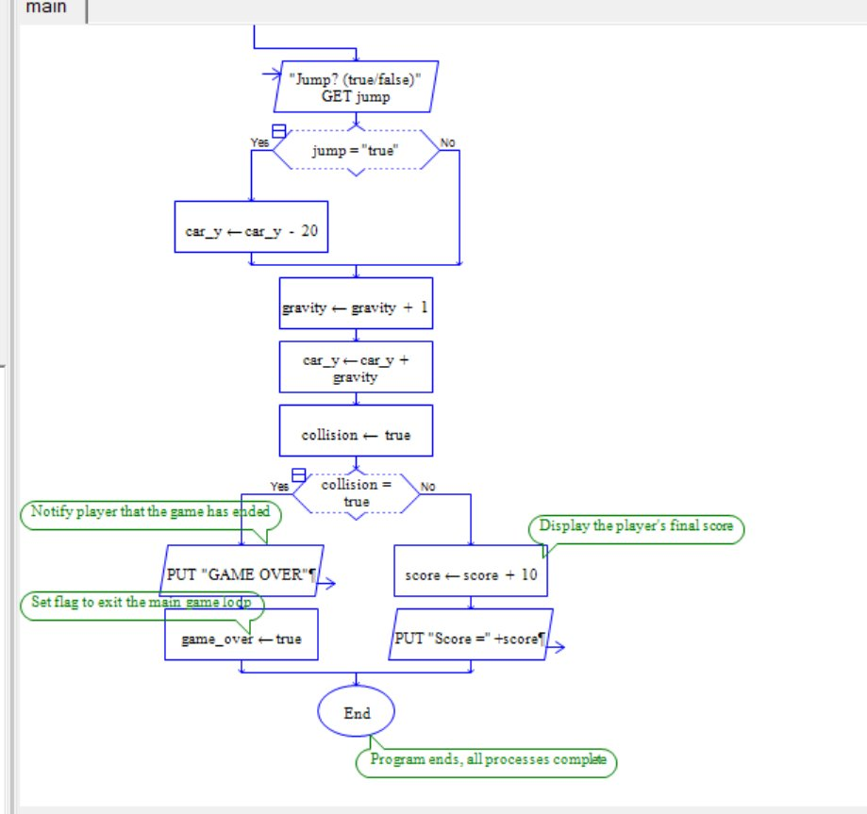
RAPTOR FLOWCHART
03b
Program logic visualized in RAPTOR -- initialization, game loop, jump mechanics, collision detection & scoring
Part 1 -- Initialization & Game Loop Setup
Part 2 -- Jump, Collision & Score Logic

Slide 6
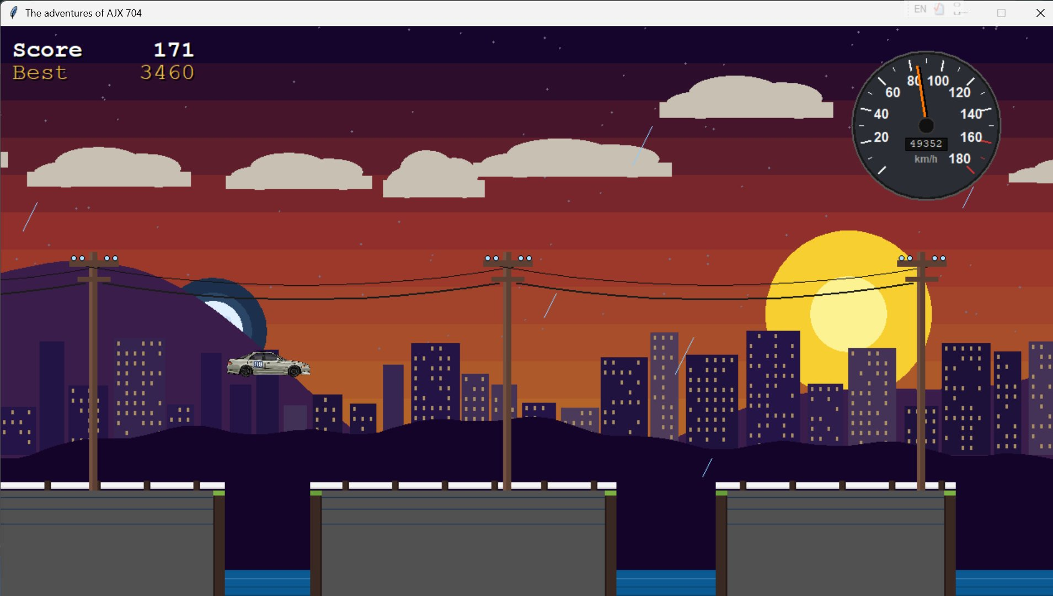
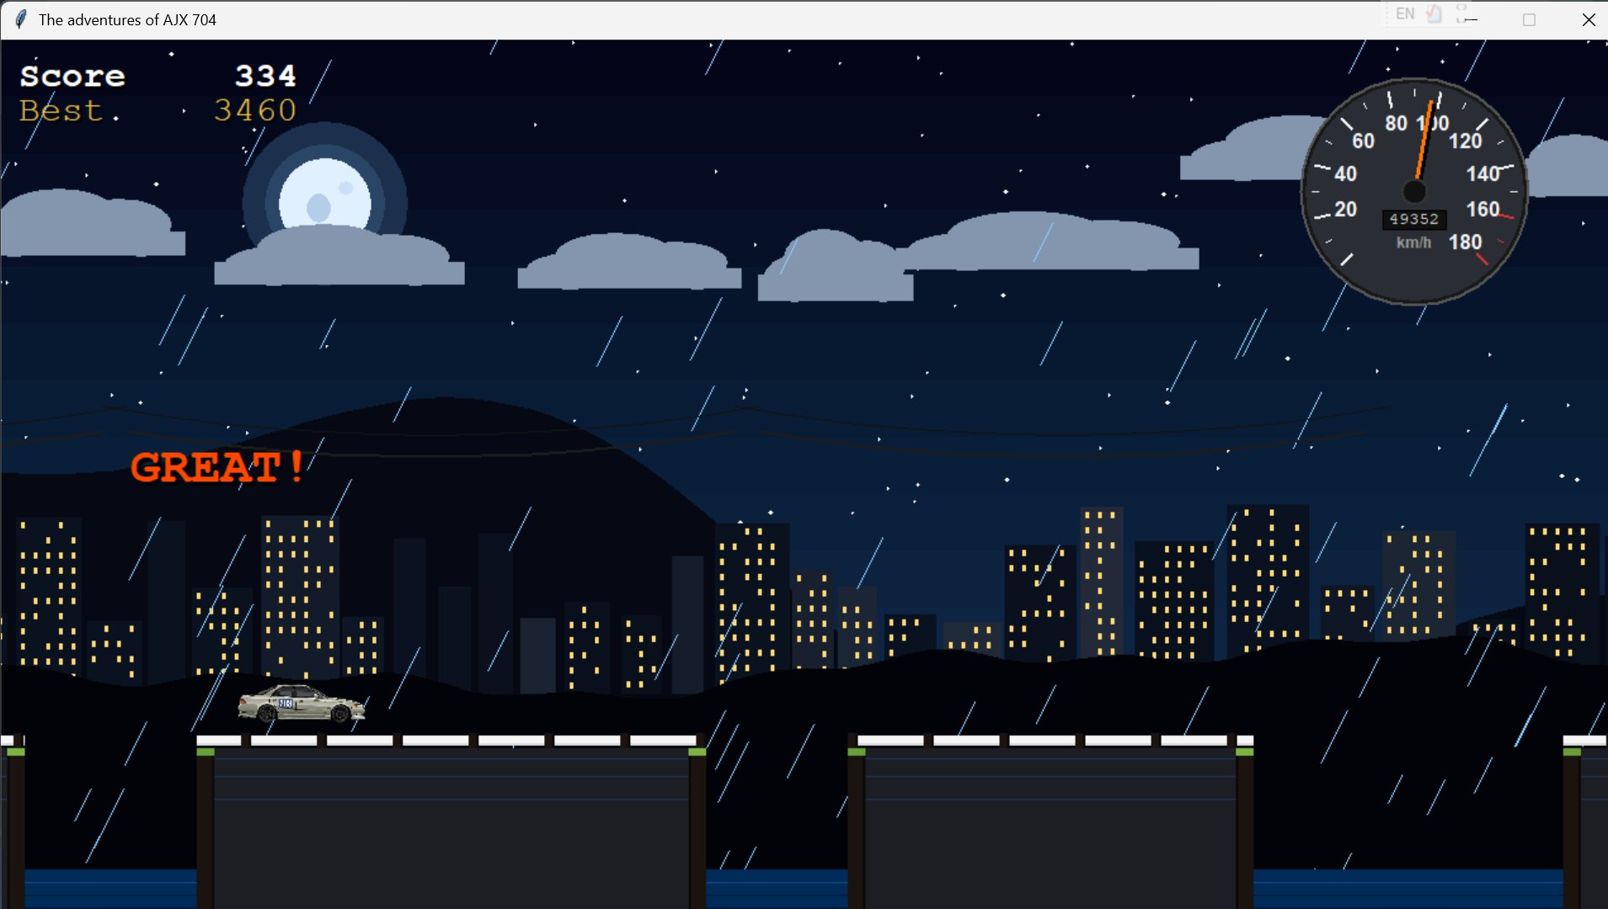
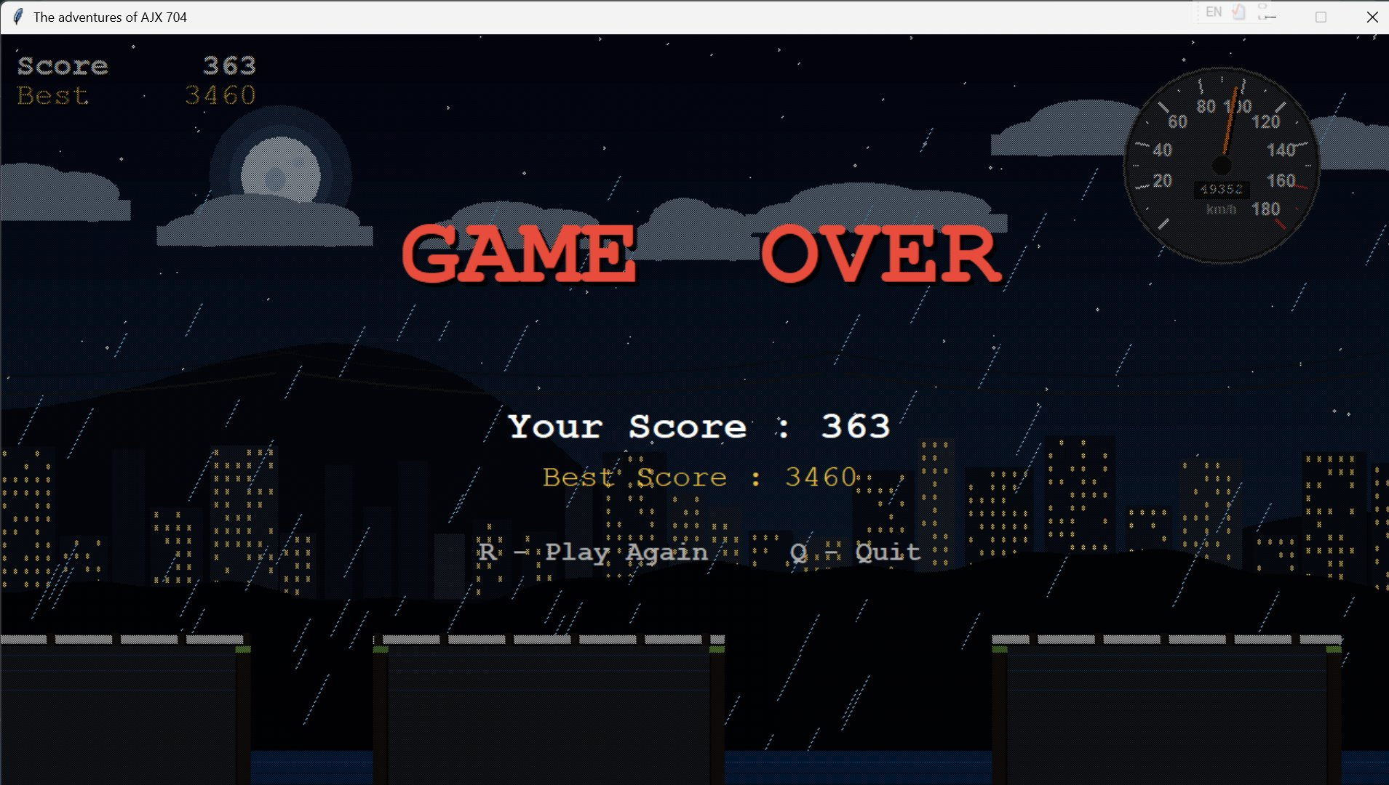
INTERFACE
04
01 Start Screen
02 Gameplay — Sunset
03 Gameplay — Night
04 Game Over Screen

Slide 7
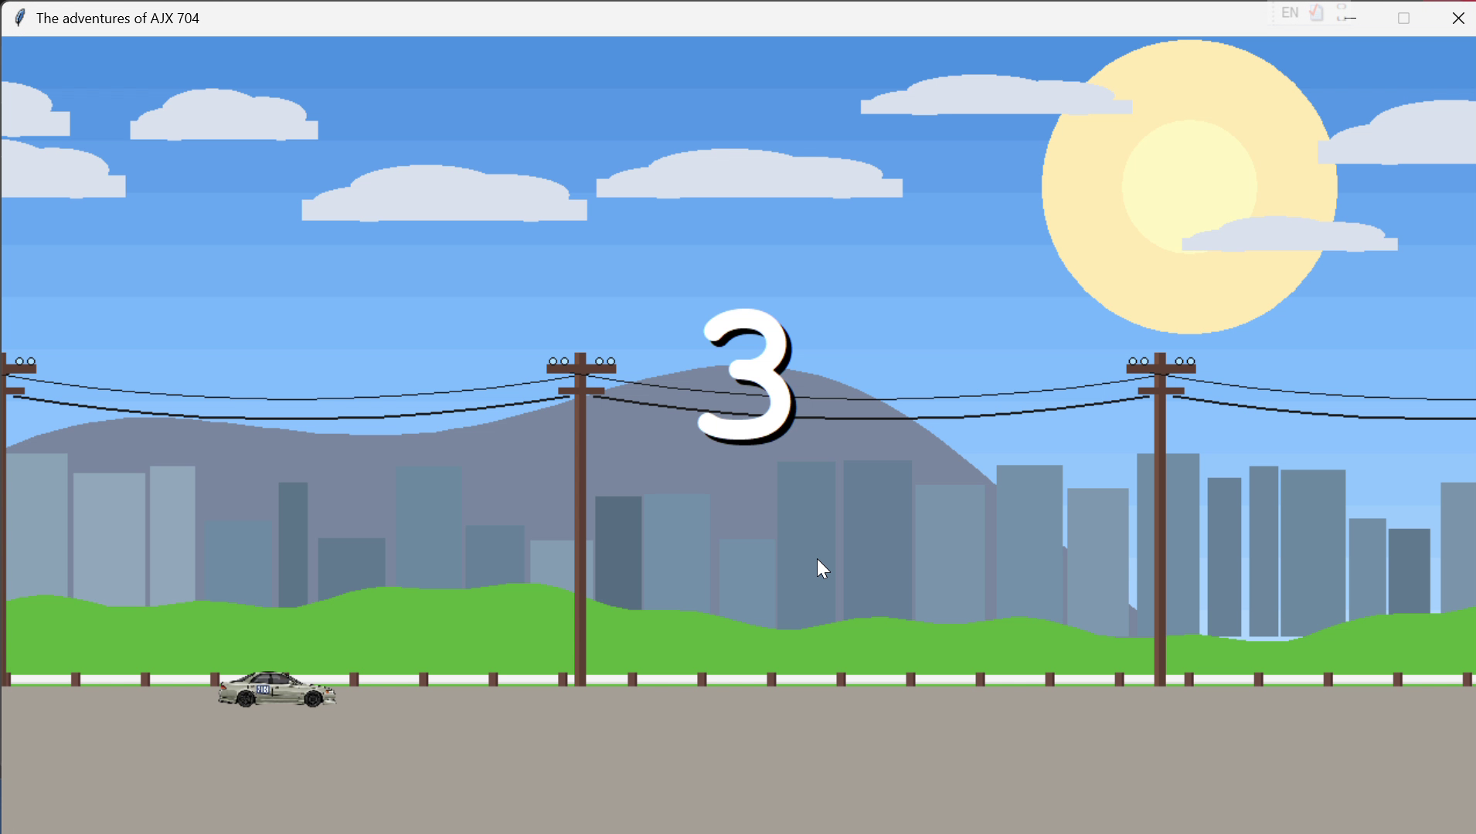
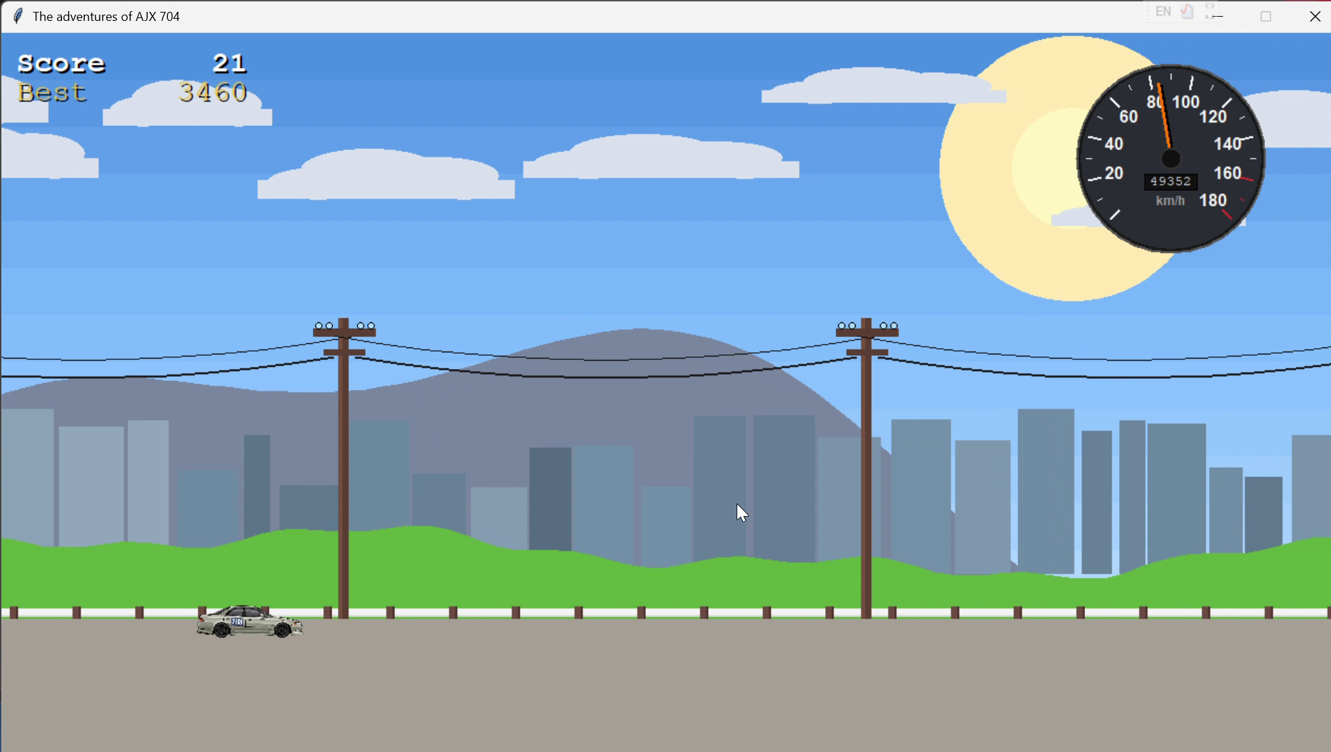
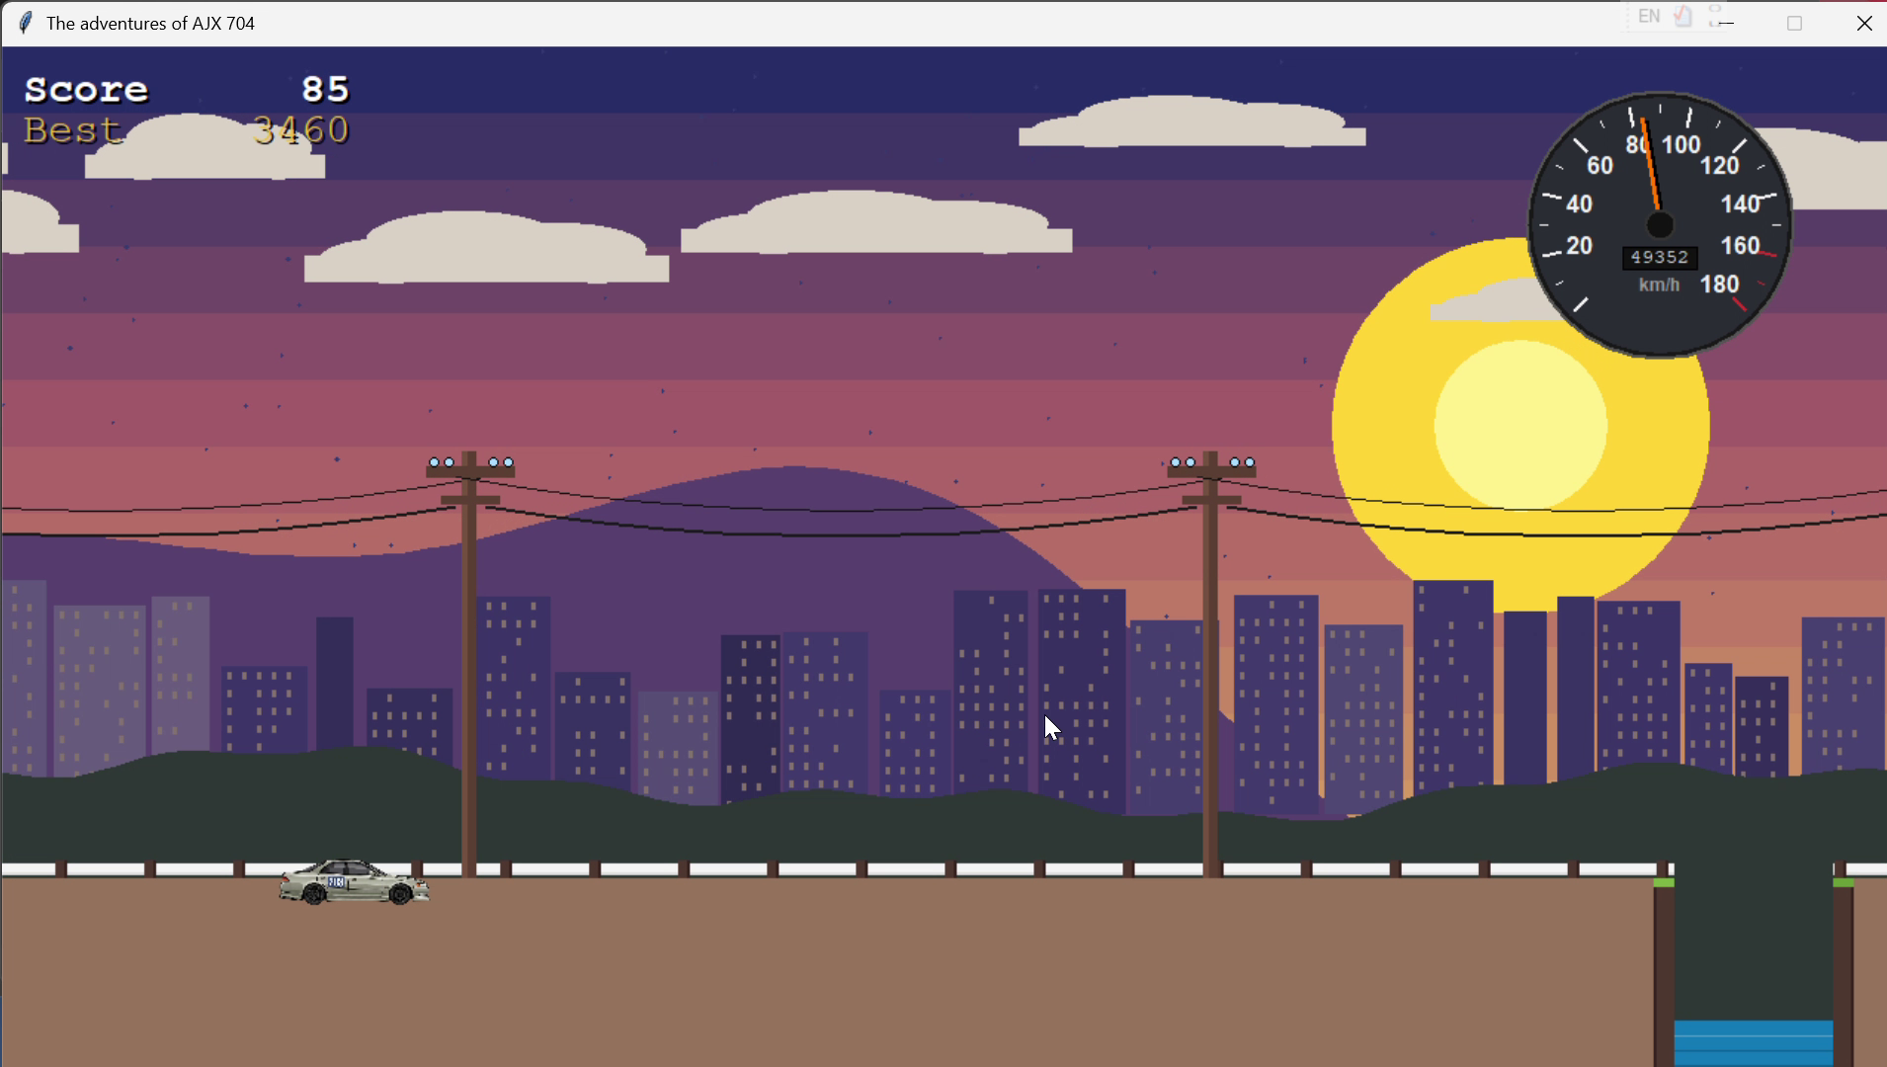
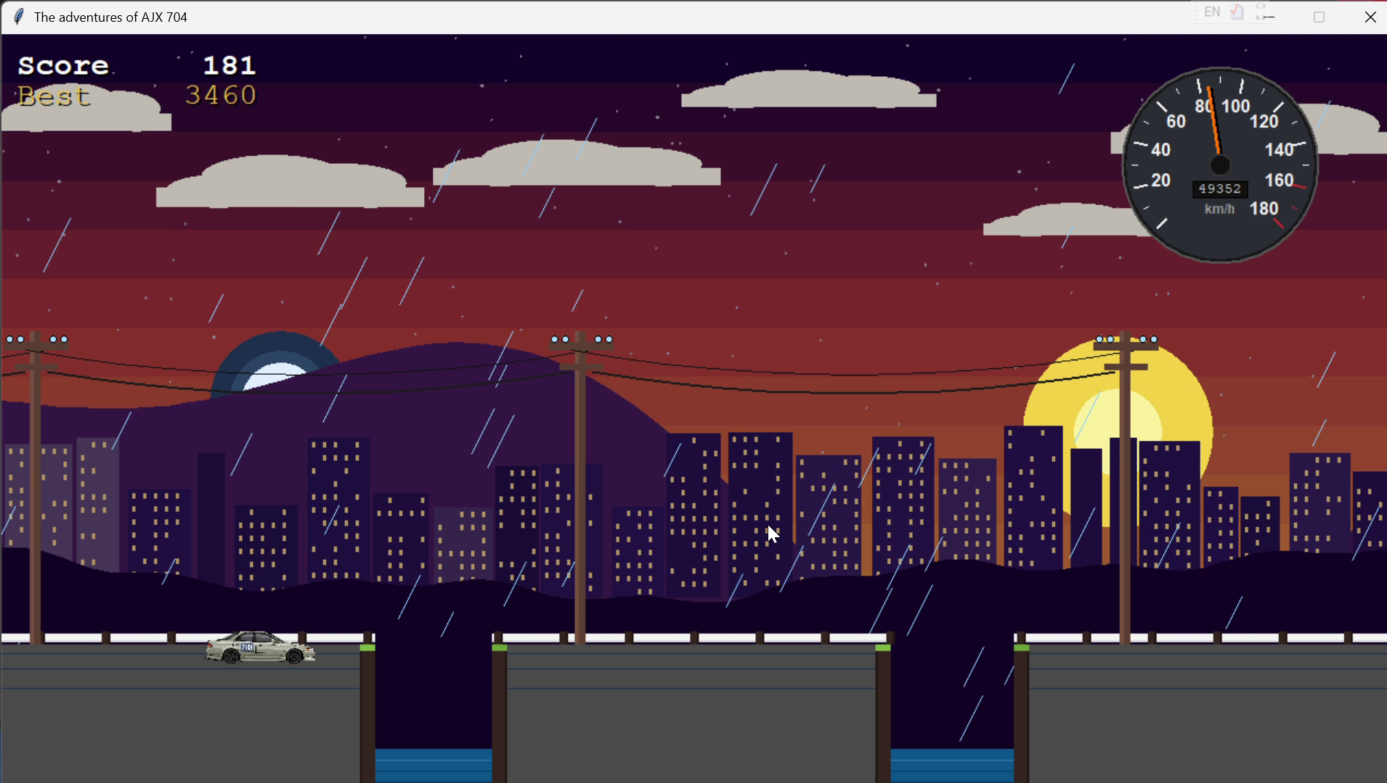
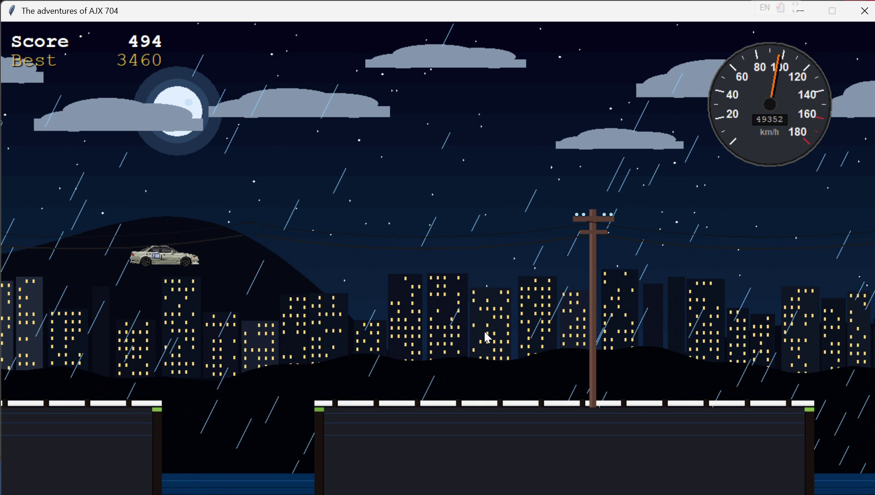
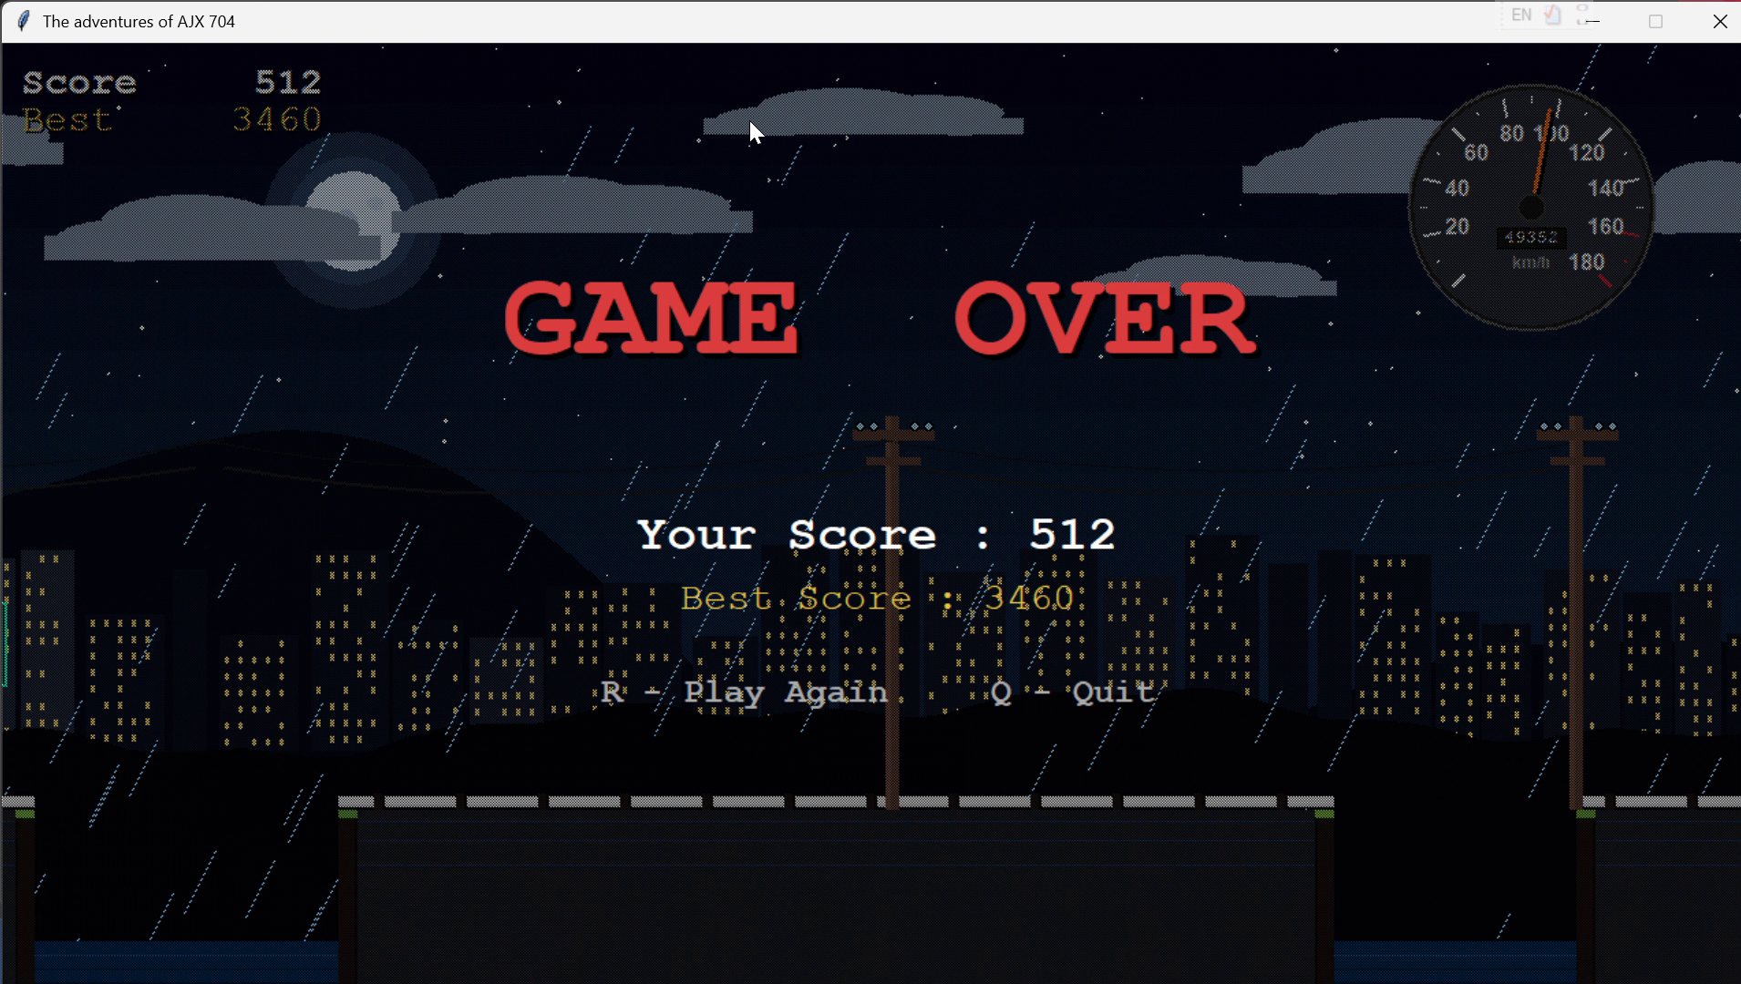
GAMEPLAY WALKTHROUGH
05
3-2-1 Countdown
Day — Score 21
Sunset — Score 85
Red Sky — Score 181
Night Jump — 494
Game Over — 512
Day ──────────────────── Sunset ──────────────── Night ➤

Slide 8
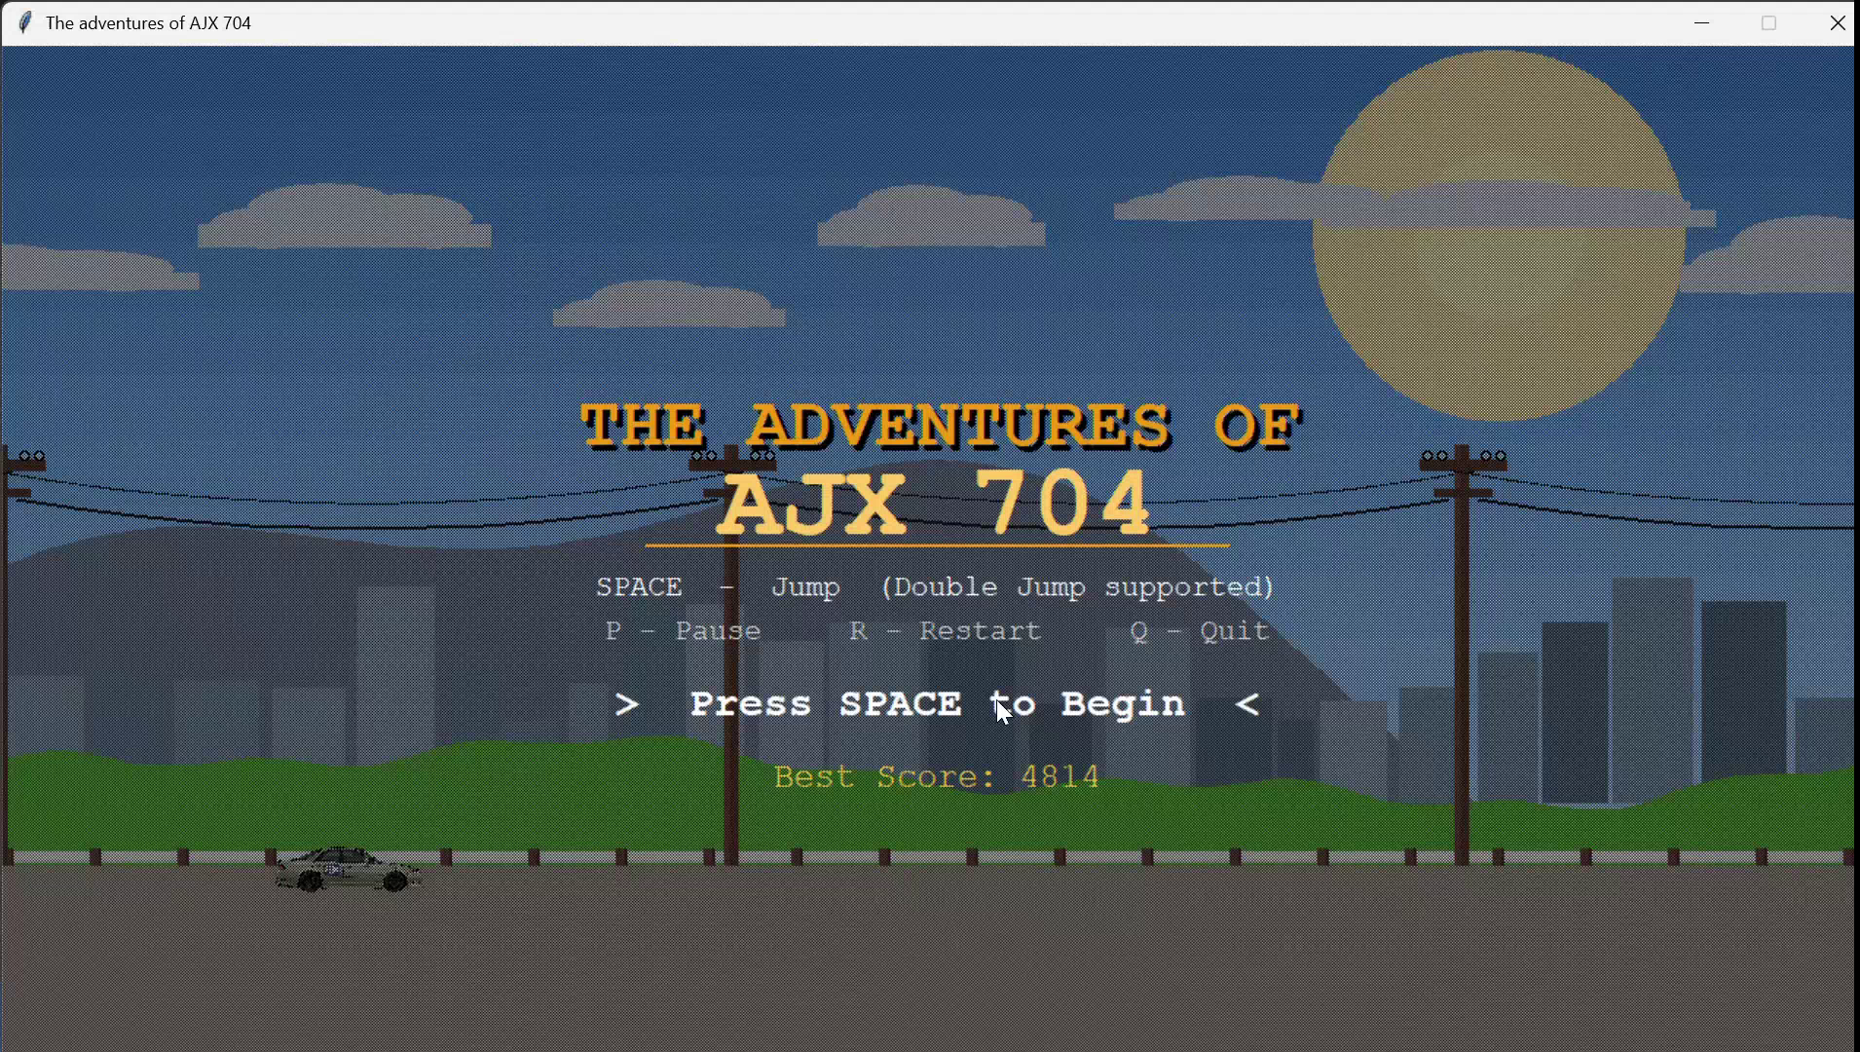
LIVE DEMO
Recorded Gameplay · 15 sec · Day → Sunset → Night → Game Over
06

Slide 9
MODULE ARCHITECTURE
07
main.py
Entry point — Resolution picker dialog, creates Tkinter window, launches Game()
config.py
Single Source of Truth — all constants: gravity, jump velocity, colours, speed thresholds
game.py
The Kernel — 60 FPS root.after() loop + Finite State Machine (START→PLAYING→DYING→GAMEOVER)
entities.py
Classes: Car, Gap, Particle, Pillar — encapsulation, polymorphism, and OOP in action
physics.py
Pure stateless functions: apply_gravity(), aabb_overlap(), clamp() — no side effects
parallax.py
7-layer rendering pipeline — sky, sun/moon, mountains, skyscrapers, wires, road, gaps
ui.py
Five overlay states: StartScreen, Countdown, HUD, PauseOverlay, GameOverScreen
assets.py
Loads car.png as Tkinter PhotoImage; reads/writes highscore.txt safely

Slide 10
CS101 CONCEPTS IN OUR GAME
08
Variables
config.py stores all constants. Car class uses self.speed, self.score, self.vy — no magic numbers anywhere.
Conditionals
AABB overlap → if True → STATE = DYING. All five game states route through an if/elif chain.
Loops
for gap in self.gaps checks all gaps per frame. for i in range(SPOKE_COUNT) draws the spinning wheel animation.
Functions
apply_gravity() and aabb_overlap() in physics.py are pure stateless functions — callable, testable, reusable.
Strings
Combo floaters (NICE!, GREAT!, AJX!) are strings. State labels (PLAYING, DYING) are string constants in config.py.
OOP / Classes
Car, Gap, Particle, Pillar classes. game.py only calls car.draw(canvas) — true encapsulation. No global state leakage.

Slide 11
THANK
YOU
The AJX-704 rides on.
SPACE Jump P Pause R Restart Q Quit
Abdul Salam SP26-BSE-004 Muhammad Fazal E Rabbi SP26-BSE-044
Built with Python + Tkinter only · No game engine · ICT Project 2026

